Slide 1
IMMUNOGLOBULIN e
Cristian Jivcu
Pulmonary Fellow BGSMC – PGY 5

Slide 2
Introduction
1 of 5 classes of antibodies (IgG, IgM, IgA, IgD and IgE)
0.002% of serum antibodies
Half-life = 2 days
Fc portion binds to mast cells and basophils where is mediates many allergic reactions.
Fc portion binds to Eosinophils enabling opsonization against parasitic infections.

Slide 3
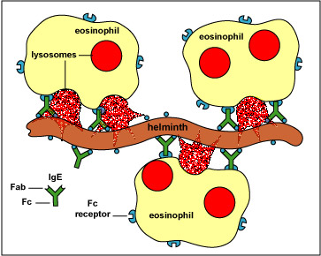
IgE in Parasitic infections

Slide 4
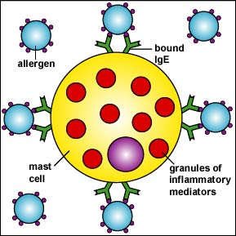
Activity of IgE in allergies

Slide 5
Causes of Elevated IgE
Category | Most common Examples
Allergic Disease | Eczema, Rhinitis, Asthma, Drug Allergies, Urticaria, Extrinsic Alveolitis, ABPA
Cestodes | Echinococcus granulosus & multicularis
Trematodes | Schistosoma mansoni, japonicum & haematobium
Nematodes | Ascaris, Ancylostoma, Capillaria phillinpinesis, Toxocara cani & cati
Monoclonal Gammopathy | IgE monoclonal gammopathy
Immune deficiency | Hyper-IgE, Wiskott-Aldrich, DiGeorge, Nezelof, Graft vs Host, HIV
Inflammatory Diseases | Kawasaki, PAN, CF
Infectious | Leprosy, Aspergilloma, Coccidiomycosis

Slide 6
Causes of Hyper IgE
Most common cause of elevated IgE
Western countries – allergies
Third world – parasitic infections.
Extreme levels (800 – 25,000IU/ml)
Severe atopic dermatitis
ABPA
Parasitic infections
IgE myeloma
Buckley Syndrome (Job’s Syndrome or Hyper IgE syndrome)

Slide 7
HIES
Identified in 1966 by Davis Schaller
Two girls w/ red hair, chronic dermatitis and recurrent staphylococcus abscesses
Disease was named after the Biblical Job

Slide 8
Hyper IgE Syndrome (HIES)
Autosomal dominant or recessive
Dominant – pts fail to lose primary teeth so can have two sets of teeth simultaneously
Recessive – severe viral infections and neurologic sequelae, often fatal in childhood
Characteristics:
Frequent Staphylococcal skin infections
Eczema-like skin rash
Severe lung infections – pneumatoceles
Very high levels of IgE (>2000 IU/ml)

Slide 9
Pathophysiology
Abnormal neutrophil chemotaxis (↓ interferon µ) is postulated as cause of disease.
This defect proved inconsistently present.
IgE usually >10x normal
↑ Eos are common in 90%

Slide 10
Diagnosis
Clinical diagnosis
Immune defects
Somatic defects
Elevated IgE
NIH developed a scoring system
Not for clinical use
Linkage studies to determine inheritance patterns.

Slide 11
Treatment
Chronic antibiotics – given repeated staph infections
Diagnosis should ideally be made in childhood to prevent pneumatocele formation
Good skin care
I&D of abscesses
Mucocutaneous candidiasis the most frequent co-infection.

Slide 12
Treatment
Typically pts are unaware of how sick they are
Fever and other markers of inflammation may not be present.
Empyema is frequently present and requires drainage.
Pulmonary cavities are at high risk for co or super-infection.
Extensive bronchiectasis.

Slide 13
Treatment
Immunomodulators have been unsuccessful
Levamisole – only RTC
INF-µ -- was inconsistent in its effects on IgE levels and infections.
Cyclosporine A – used successfully in Israel but results not officially published.
IVIG – reasonable option given that encapsulated organisms are most often at fault.

Slide 14
References
Grimbacher Bodo, Steven M Holland, Puck Jennifer, Hyper-IgE syndromes. Immunological Reviews 2005. Vol 203: 244-250
http://www.clinlabnavigator.com/Test-Interpretations/immunoglobulin-e-ige.html
Para FM – Extreme increase of total IgE with Eosinophilia, case report; Allergol Immunol Clin 2000;15:194-197.

